Slide 1


Building a System for Energy measurement in OpenHardware
MiSCIT 2020-2021
Supervisor: Jérôme FERRARI
Co-Supervisors : Assoc. Prof. Benoit DELINCHANT
Research Director Frédéric WURTZ
Student: HO Vu Duy Bao
Class: MiSCIT - IPA

Slide 2

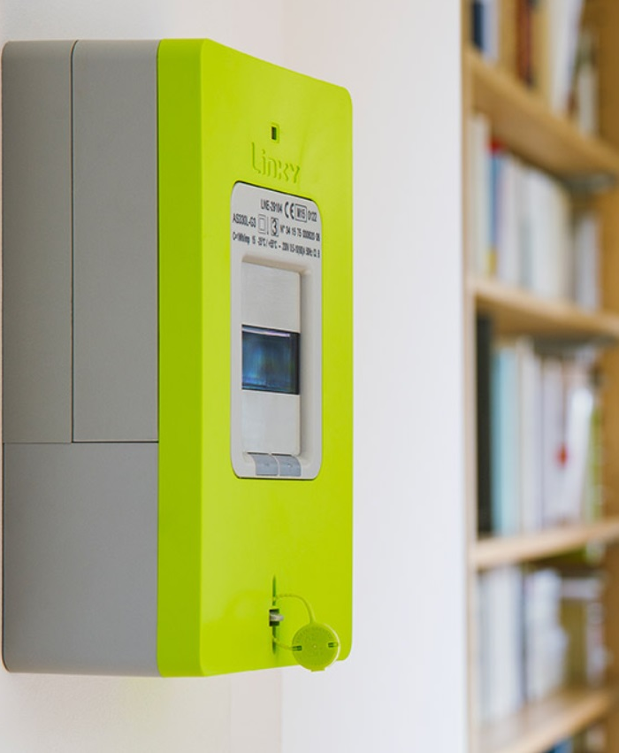
Plan
Introduction
System Analysing and Hardware
LoRa and Application server
Review and Prospects
I. Introduction
Context
Objectives
II. System Analysis & Hardware
Linky & LinkyTIC
LoKy
III. LoRa & Application Server
LoRaWAN and TTN
Application server
IV. Review and Prospects
28/06/2021

Slide 3
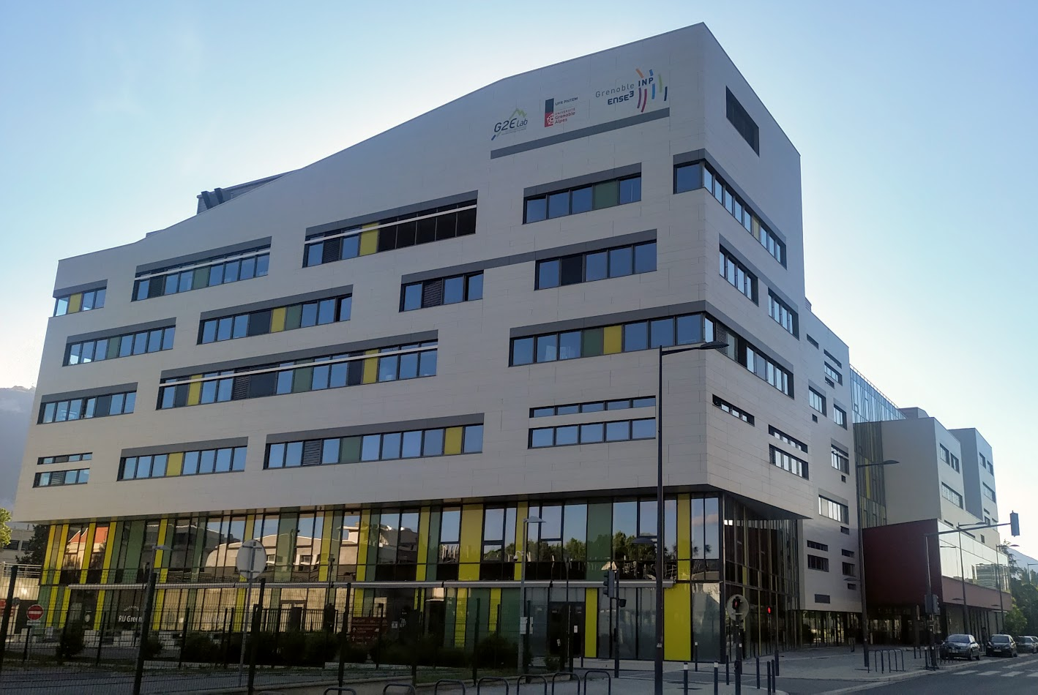

Introduction
System Analysing and Hardware
LoRa and Application server
Review and Prospects
Introduction
Energy distribution:
Decentralization!!!
→ Complex set of producers and consumers
→ Difficult to manage
Solution?
Smart building
28/06/2021

Slide 4

Introduction
System Analysing and Hardware
LoRa and Application server
Review and Prospects
Introduction
A system:
→ Manage the users’ energy consumption
→ Private communication network
The first step to build this system
Framework of project:
Collect and Process energy data at level of a city and internal of buildings
Create a low-power device
Collect and secure data in a digital- safe using APIs
Data processing and visualization
Basic requirements
28/06/2021

Slide 5
Introduction
System Analysing and Hardware
LoRa and Application server
Review and Prospects
Solution
Smart meter
Application server
Datacenter
Connection device
Figure 1: LoKy system blocks diagram
28/06/2021

Slide 6
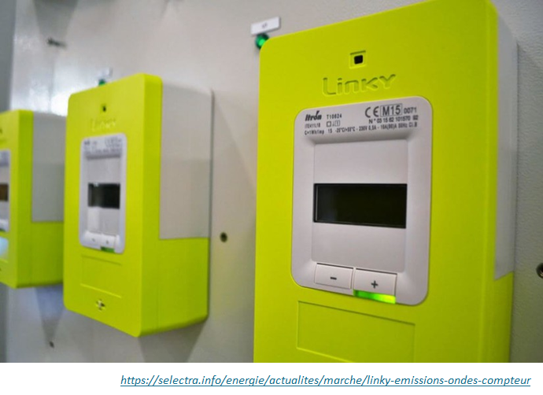
Introduction
System Analysing and Hardware
LoRa and Application server
Review and Prospects
Linky
Retrieve historical power consumption data
Control electrical appliances in customers' homes
Measure both of the electrical production and consumption
Receive bills based on the actual consumption
Figure 2: Linky smart meter
28/06/2021

Slide 7
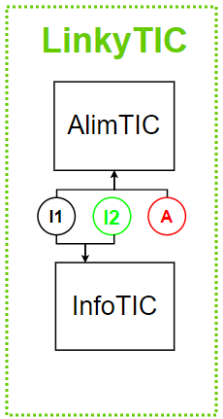
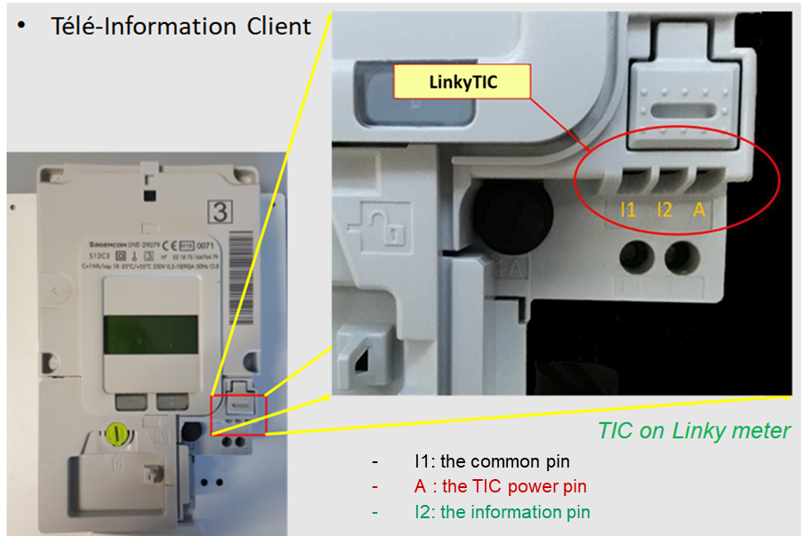
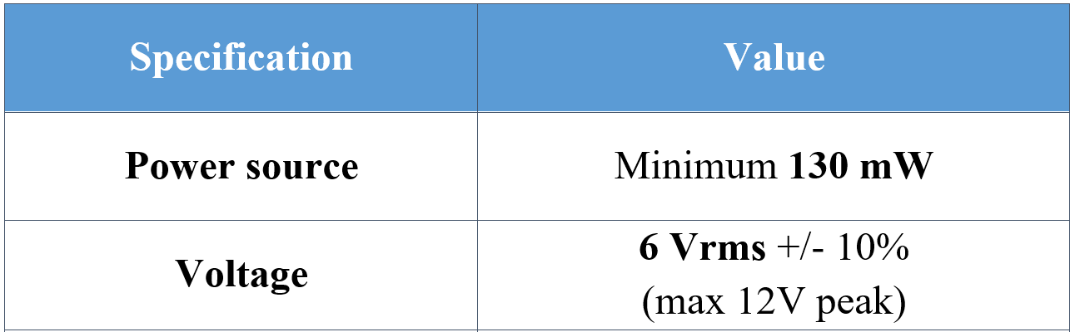
Introduction
System Analysing and Hardware
LoRa and Application server
Review and Prospects
LinkyTIC
Figure 3: Digital output TIC of Linky
Table 1: AlimTIC specification
28/06/2021

Slide 8
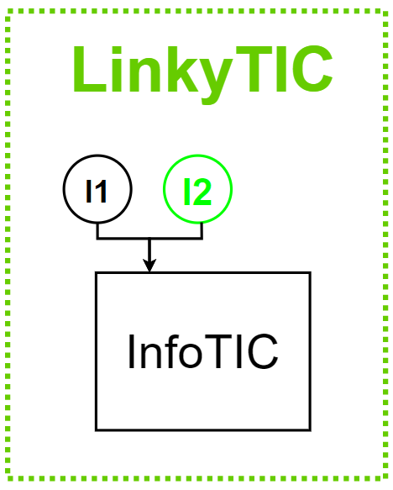
InfoTIC
Introduction
System Analysing and Hardware
LoRa and Application server
Review and Prospects
ASK signal with transmission rate 1200 bauds:
IINST : Instantaneous current in A,
PAPP : Apparent power in VA,
HCHC : Off-peak hours index in Wh,
HCHP : Full hours index in Wh,
BASE : Total consumption index in Wh
28/06/2021

Slide 9
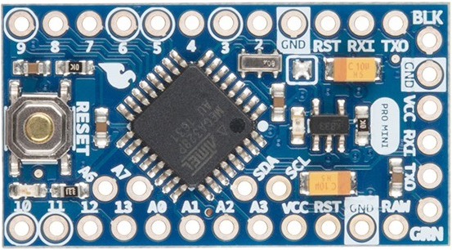
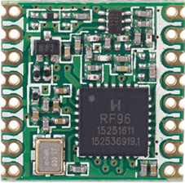
Introduction
System Analysing and Hardware
LoRa and Application server
Review and Prospects
µController & LoRa module
SPI
Figure 4: Arduino Pro Mini 3.3V (18x33mm)
Figure 5: RFM95W LoRa (16x16mm)
28/06/2021

Slide 10
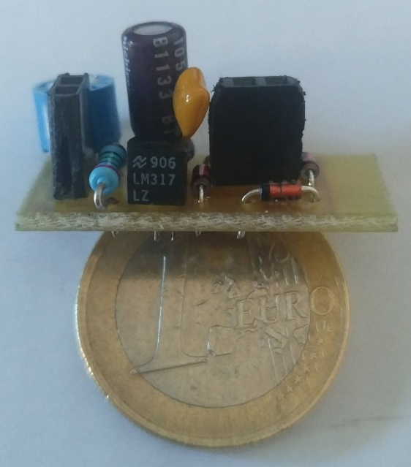
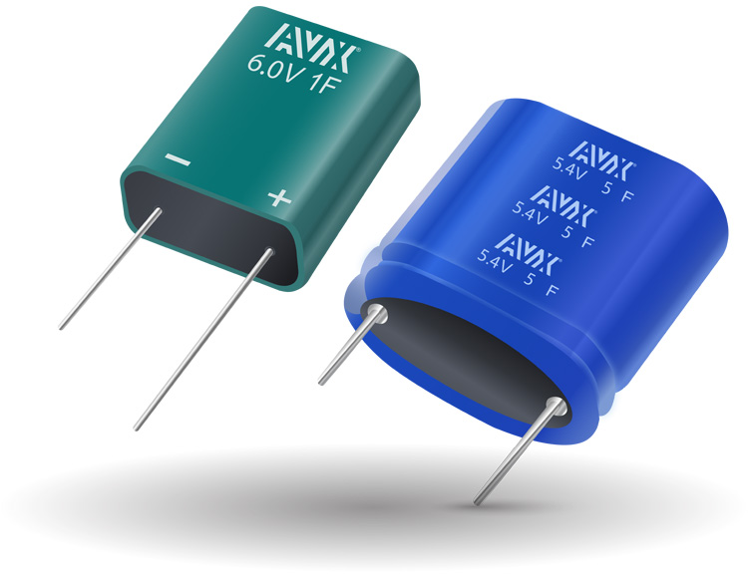

Low-Power Solution
Introduction
System Analysing and Hardware
LoRa and Application server
Review and Prospects
Figure 6: Power support module with Supercapacitor 0,47 Farad (@5.5V)
Figure 7: Optocoupler PC814
to Demodulate and Decode
28/06/2021

Slide 11
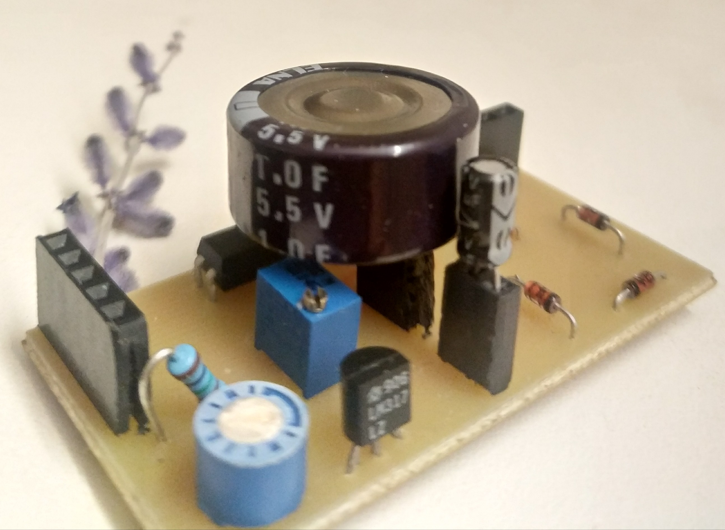
Combination
Introduction
System Analysing and Hardware
LoRa and Application server
Review and Prospects
Figure 8: LoKy support board (ver.0)
28/06/2021

Slide 12
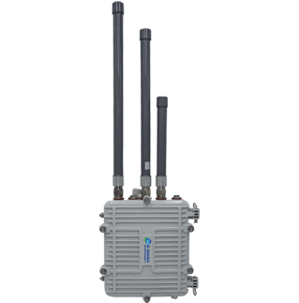

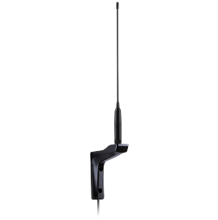


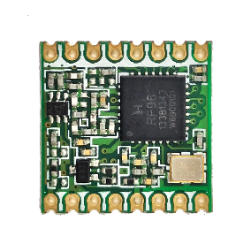



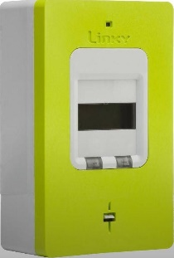


Platform
Introduction
System Analysing and Hardware
LoRa and Application server
Review and Prospects
LoKy
Collect Linky power consumption information
Self-powered by LinkyTIC
TCP/UDP
MQTT
SPI
Arduino Pro Mini
3V3 8MHz
RFM95W
868MHz
LoRaWAN Gateway
Network Server
Application Server
UART
Forwarding LoRaWAN packets from LoKy to TTN
Creating Internet connection for the applications
Database : InfluxDB
Visualizing : Grafana
(Grafana queries InfluxDB periodically via HTTPS)
Data transmission by LoRa
HTTP/HTTPS
Linky TIC
Figure 9: LoKy platform
28/06/2021

Slide 13


LoRa & The Things Network
Introduction
System Analysing and Hardware
LoRa and Application server
Review and Prospects
Figure 10: LoRa in smart city
Open and free-to-use network server
*https://elainnovation.com/en/lorawan-private-network-vs-public-network-whats-the-difference/
28/06/2021

Slide 14
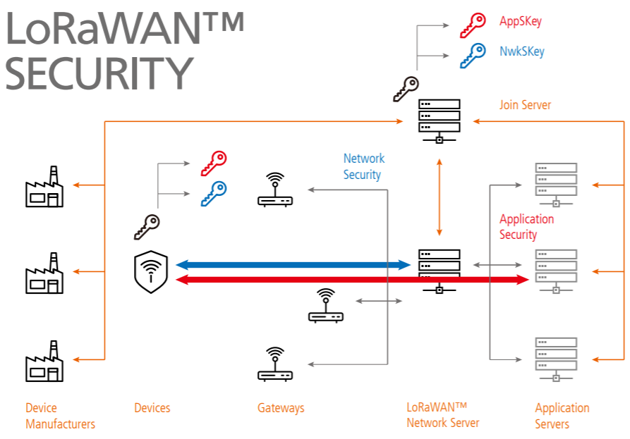
LoRaWAN security
Introduction
System Analysing and Hardware
LoRa and Application server
Review and Prospects
Figure 11: LoRaWAN security scheme
https://lora-alliance.org/wp-content/uploads/ 2020/11/lorawan_security_whitepaper.pdf
28/06/2021
Notes:
Network Session Key (NwkSKey): used by the network server to authenticate the device
Application Session Key (AppSKey): used by the application server to decrypt data from application server.

Slide 15
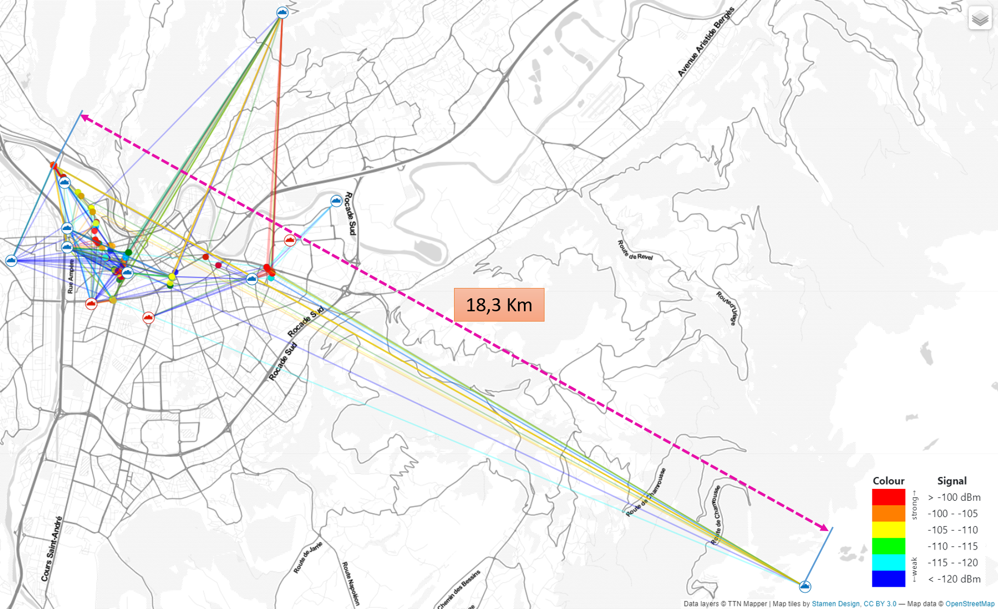

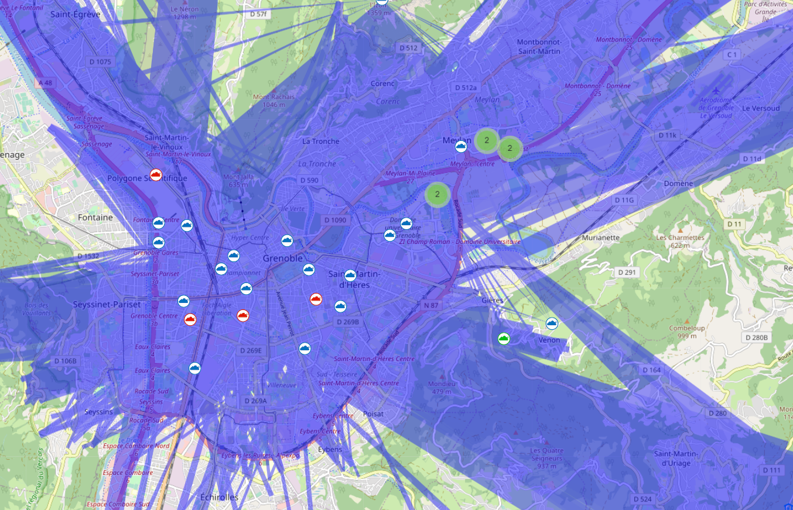
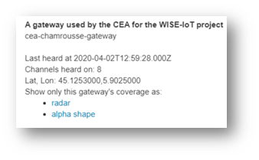
TTN Mapper & LoRaWAN gateway coverage
Introduction
System Analysing and Hardware
LoRa and Application server
Review and Prospects
18,3 Km
Figure 12: LoRa coverage in Grenoble
28/06/2021

Slide 16
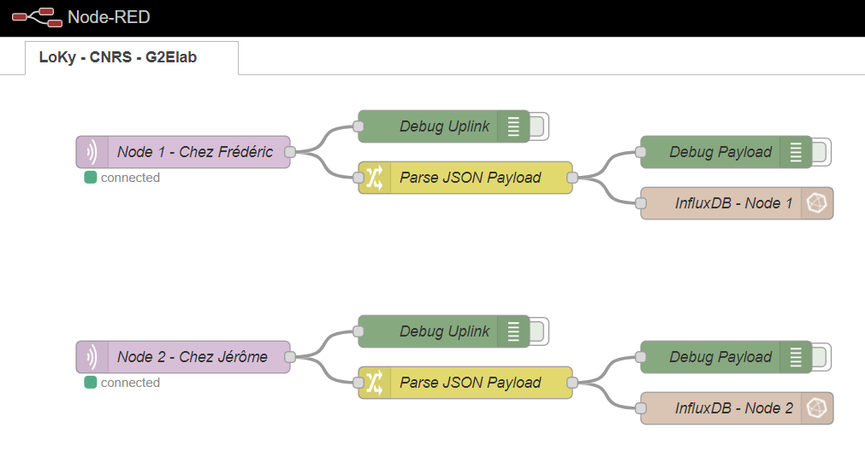
The Trio: Node-RED, InfluxDB & Grafana
Introduction
System Analysing and Hardware
LoRa and Application server
Review and Prospects
MQTT
Figure 13: Data flow on the application server
28/06/2021

Slide 17
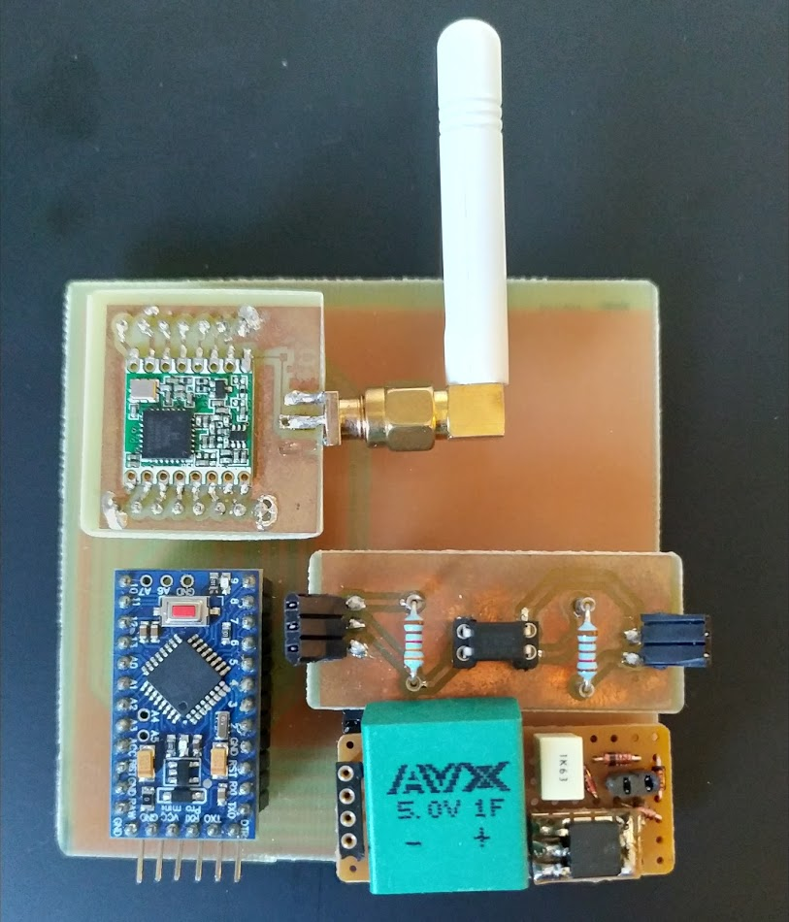
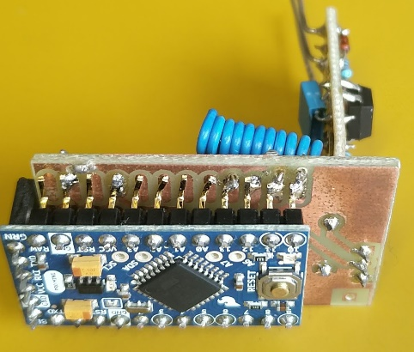
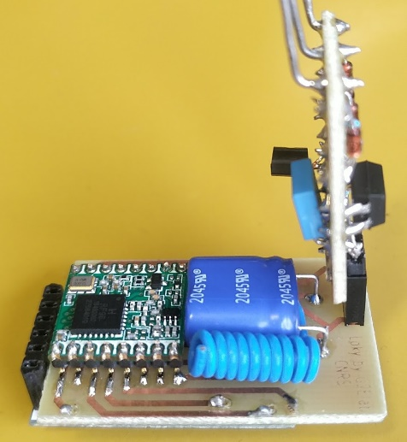


Prototypes
Introduction
System Analysing and Hardware
LoRa and Application server
Review and Prospects
LoRa Module
Microcontroller
Decoder
Power Support
Figure 14: LoKy debug board (ver.1)
Figure 15: LoKy device (ver.2)
28/06/2021

Slide 18
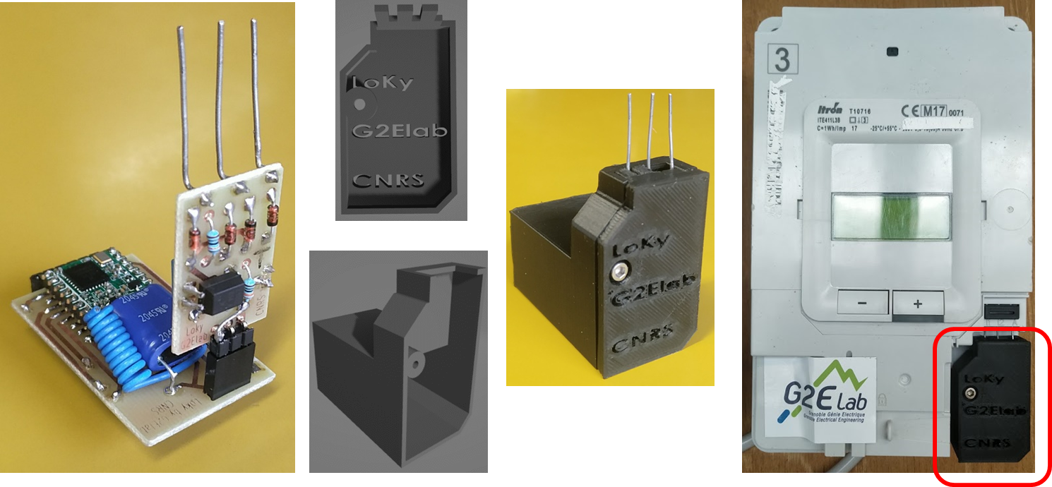
Prototypes
Introduction
System Analysing and Hardware
LoRa and Application server
Review and Prospects
Figure 16: LoKy integrated on Linky meter
28/06/2021

Slide 19
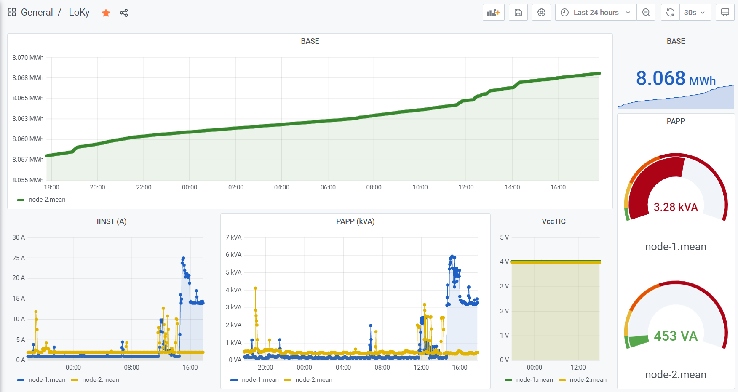
Results
Introduction
System Analysing and Hardware
LoRa and Application server
Review and Prospects
Figure 17: Data visualization on LoKy dashboard (Grafana)
28/06/2021

Slide 20
Review and Prospects
Introduction
System Analysing and Hardware
LoRa and Application server
Review and Prospects
Points to improve:
A private network for LoKy
Users account management
System integration with the datacenter
Prospects:
Solved the decentralization in energy distribution
Created the stepping stone to develop for Smart City
28/06/2021

Slide 21

28/06/2021

